Slide 1



WATER QUALITY PREDICTION
NAME : PAIDI NAVEEN
AICTE Student ID : STU682b174327cce1747654467
AICTE Internship ID : INTERNSHIP_1746416864681834e0e35d8

Slide 2

Learning Objectives
Gained a solid understanding of core Machine Learning concepts such as data preprocessing, model training, and evaluation.
Learned to handle missing values in datasets using appropriate imputation techniques.
Trained a Regression Model using Multi-Output Regressor and Random-Forest Regressor for Multi-Target Prediction.
Predicted pollutant levels for a specific station and year using historical data.
Developed a scoring system to classify water quality into categories like Good, Moderate, and Poor based on prediction outputs.
Built and deployed a user-friendly web interface using Streamlit for interactive predictions.
GOAL

Slide 3
Tools and Technology used
Core Programming Language:
Python: The foundational language for all data processing, model development, and application deployment due to its extensive libraries and vibrant community.
Data Handling and Manipulation:
Pandas: Indispensable for efficient data loading, cleaning and structuring of the water quality dataset.
Numpy: Provides powerful numerical computing capabilities, essential for array operations and mathematical functions.
Machine Learning Ecosystem:
Scikit-learn: The primary library for building the predictive model.
MultiOutputRegressor : Crucial for handling the prediction of multiple pollutant levels simultaneously, wrapping a single-output estimator.
RandomForestRegressor : Chosen as the base estimator for its robustness, ability to handle non-linear relationships, and good performance on diverse datasets.

Slide 4
Tools and Technology used
Interactive Application Development:
Streamlit: The chosen framework for rapidly building and deploying the interactive web application ( my_app.py ). It simplifies the creation of user interfaces with minimal code, allowing users to input data and receive predictions directly.
Development and Analysis Environment:
Jupyter Notebook : The WaterQualityPrediction .ipynb file use for exploratory data analysis (EDA), initial data preprocessing steps and iterative development. Its cell-based structure facilitates experimentation and visualization.
Python Scripts : Used for the final deployable application my_app.py and potentially for utility scripts.

Slide 5
Methodology
Data Acquisition and Initial Exploration.
Feature Engineering and Selection.
Handling Missing Values (Implicit in provided code, but critical).
Model Development and Training.
Model Persistence
Scoring System to classify Water Quality.
Application Deployment (Streamlit).

Slide 6
Problem Statement:
The Escalating Crisis of Water Pollution:
Water is a fundamental resource, yet its quality is increasingly compromised by industrial discharge, agricultural runoff, urban waste, and climate change impacts. This pollution manifests in various forms, including elevated levels of organic matter (affecting O2), nitrates (NO3), nitrites (NO2), sulphates (SO4), phosphates (PO4), and chlorides (CL). These contaminants pose severe threats to aquatic ecosystems, leading to biodiversity loss, eutrophication, and disruption of natural water cycles.
Direct Impact on Human Health and Socio-Economic Stability:
Contaminated water sources are a primary vector for waterborne diseases, significantly impacting public health and placing immense strain on healthcare systems. Economic sectors that rely on clean water—such as agriculture, fisheries, and tourism—suffer considerable losses due to degraded water quality. The long-term societal costs associated with water treatment, health complications, and environmental remediation are substantial and continuously increasing.
Limitations of Traditional Water Quality Monitoring:
Current monitoring practices often rely on infrequent manual sampling and laboratory analysis, which are time- consuming, labour intensive, and provide only snapshot insights into water quality. This reactive approach makes it difficult to detect rapid changes in pollutant levels, recognize emerging threats, or initiate timely interventions. Additionally, the volume and complexity of water quality data render manual trend analysis and forecasting nearly impossible, thereby hindering proactive water management strategies.

Slide 7
Solution:
Introducing the Water Pollutants Predictor: An AI-Driven Approach:
Our solution is an innovative, machine learning-powered application designed to address the critical need for proactive water quality management. It leverages historical water quality data to build a robust predictive model capable of forecasting key pollutant levels. The core idea is to transform raw, historical measurements into actionable insights, enabling stakeholders to anticipate and mitigate pollution risks effectively.
Core Functionality: Multi-Output Pollutant Forecasting:
The system takes 'Year' and 'Station ID' as primary inputs, representing the temporal and spatial context of the water sample. It then predicts the concentrations of six crucial water pollutants simultaneously: Oxygen (O₂), Nitrates (NO₃), Nitrites (NO₂), Sulphates (SO₄), Phosphates (PO₄), and Chlorides (Cl). This multi-output approach provides a comprehensive overview of water quality, allowing for a holistic understanding of the chemical composition.
Intuitive User Interface for Accessibility:
Developed using Streamlit, the application features a clean, user-friendly web interface. Users can easily input the desired year and station ID, and with a single click, receive instant predictions. This accessibility ensures that environmental agencies, researchers, and even concerned citizens can utilize the tool without requiring deep technical expertise.

Slide 8
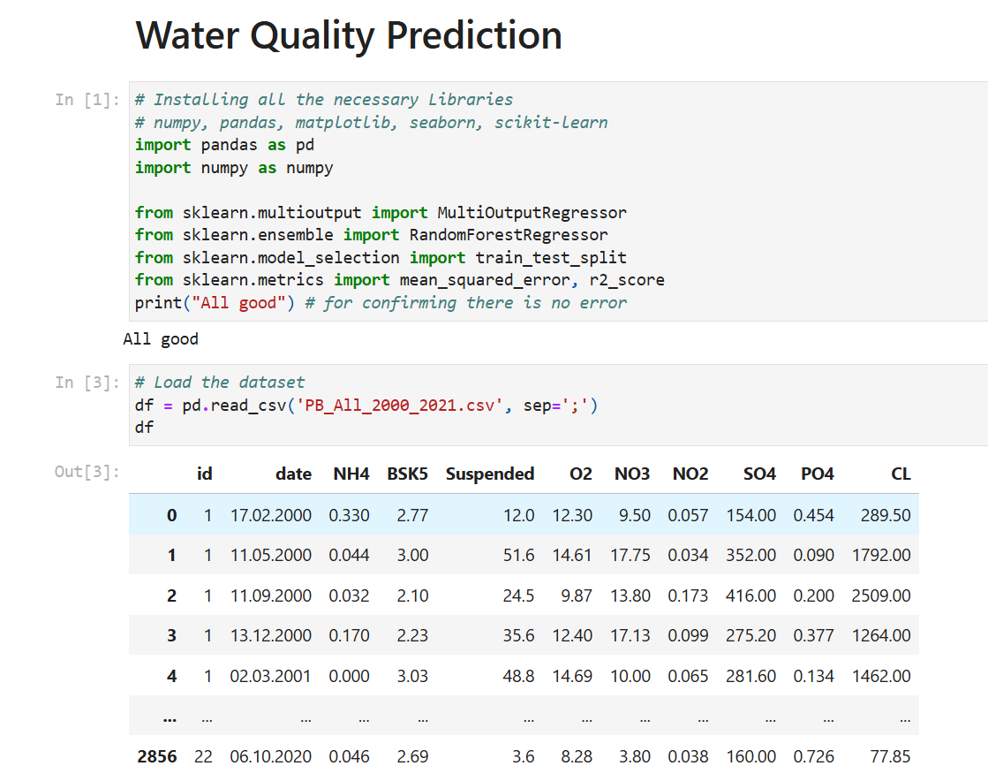
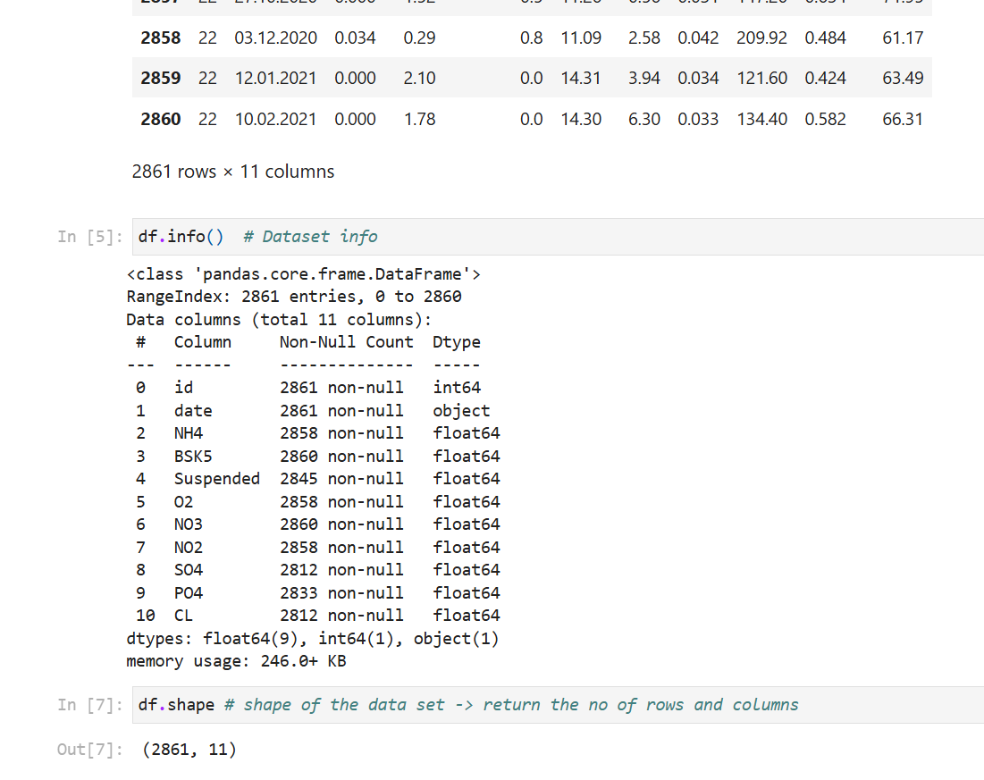
Screenshot of Output:

Slide 9
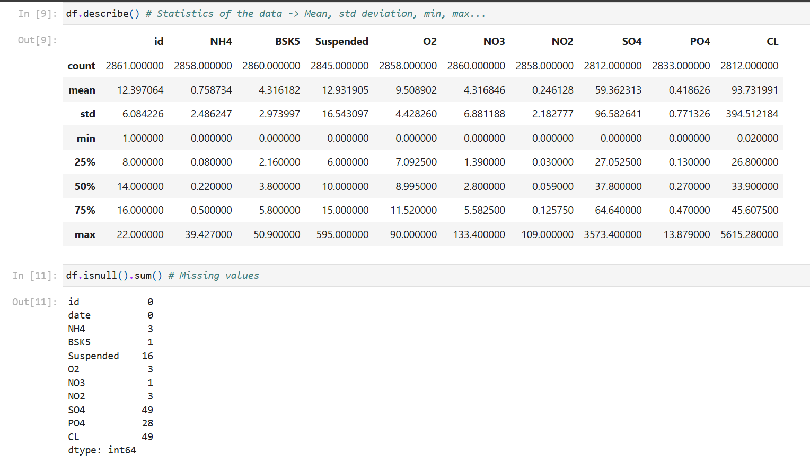
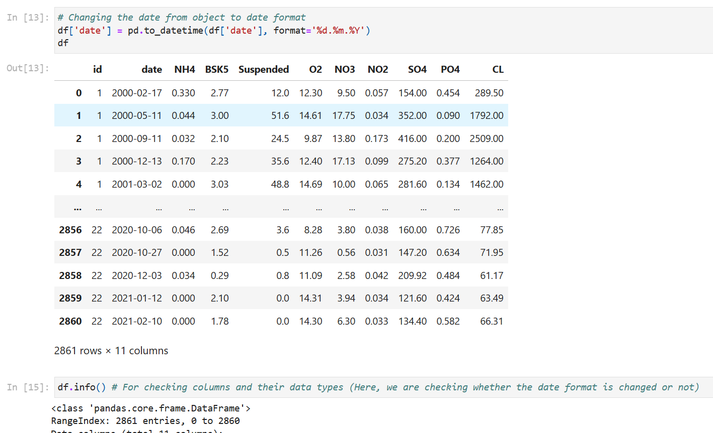
Screenshot of Output:

Slide 10
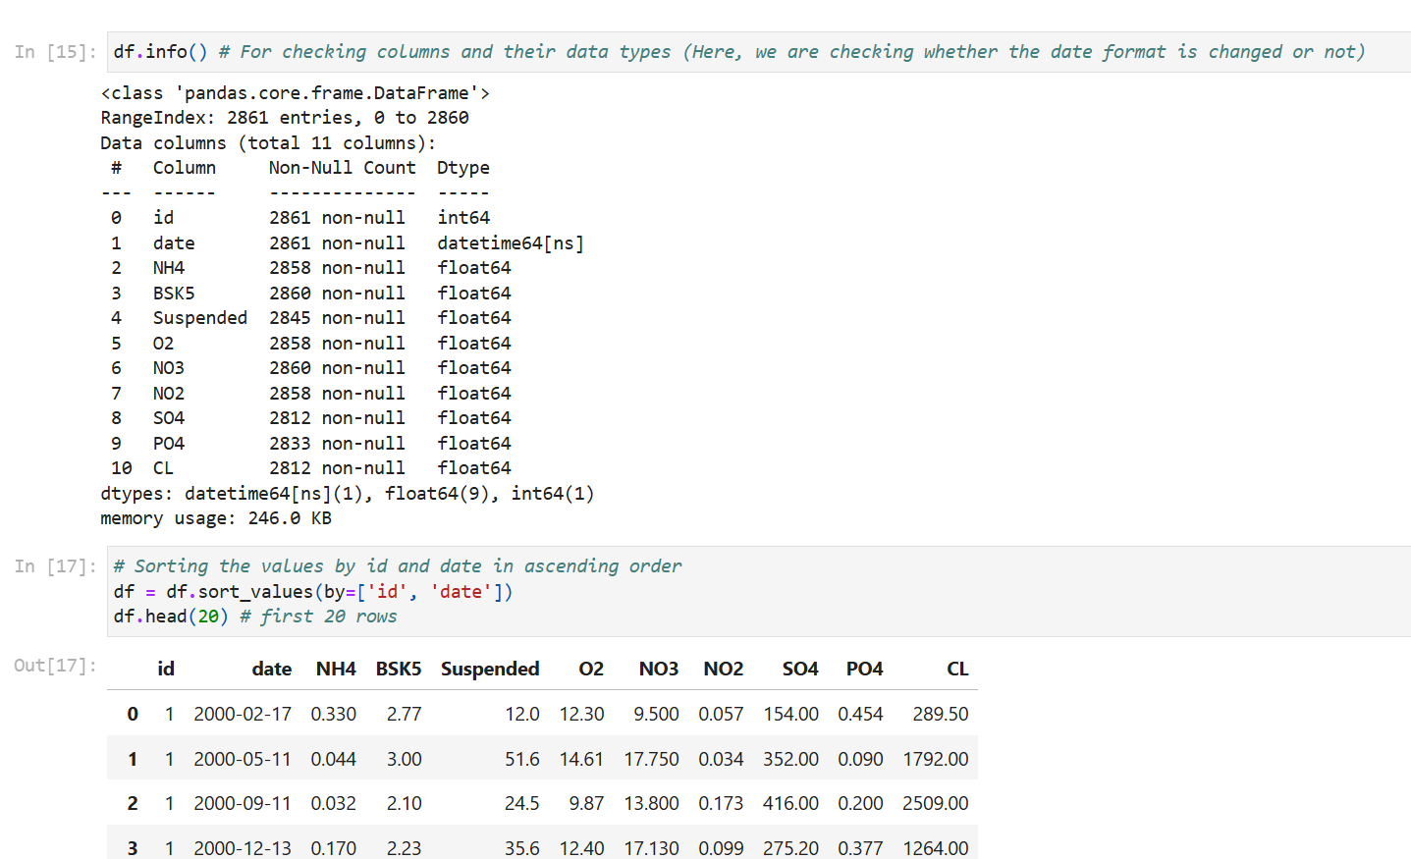
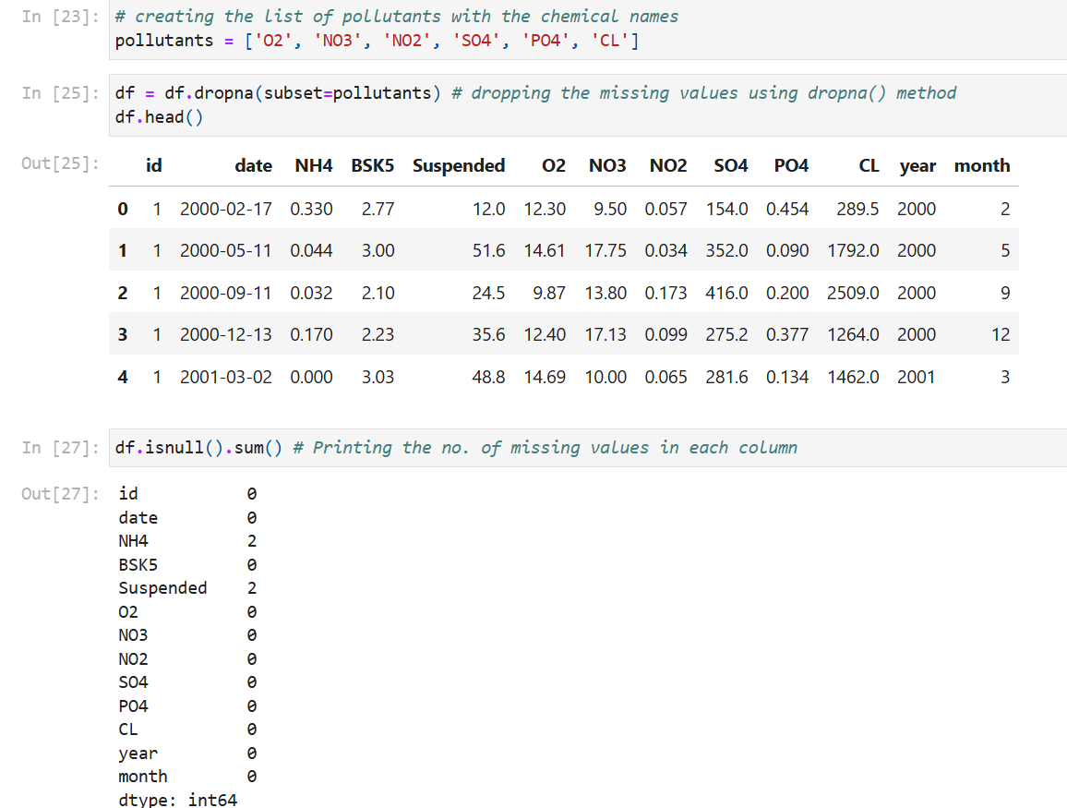
Screenshot of Output:

Slide 11
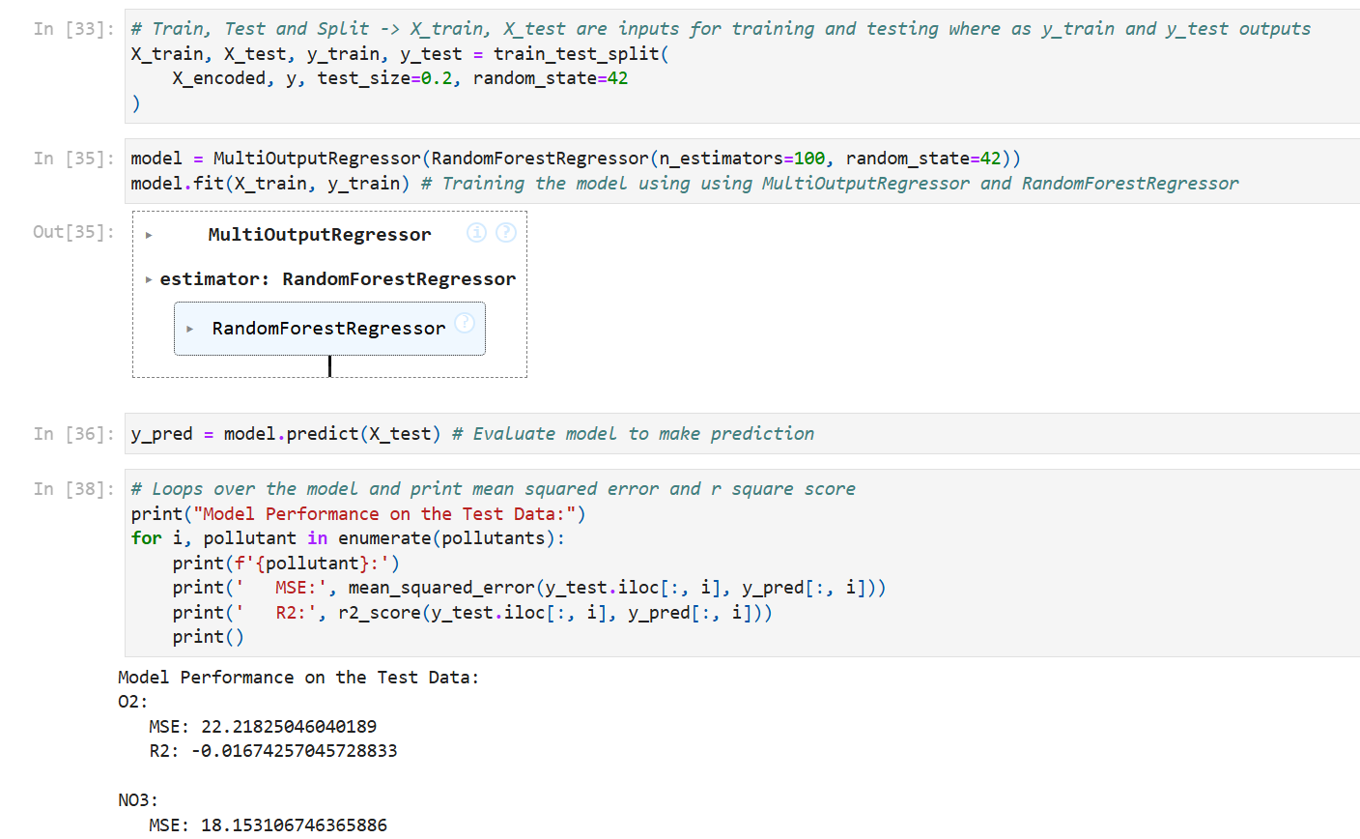
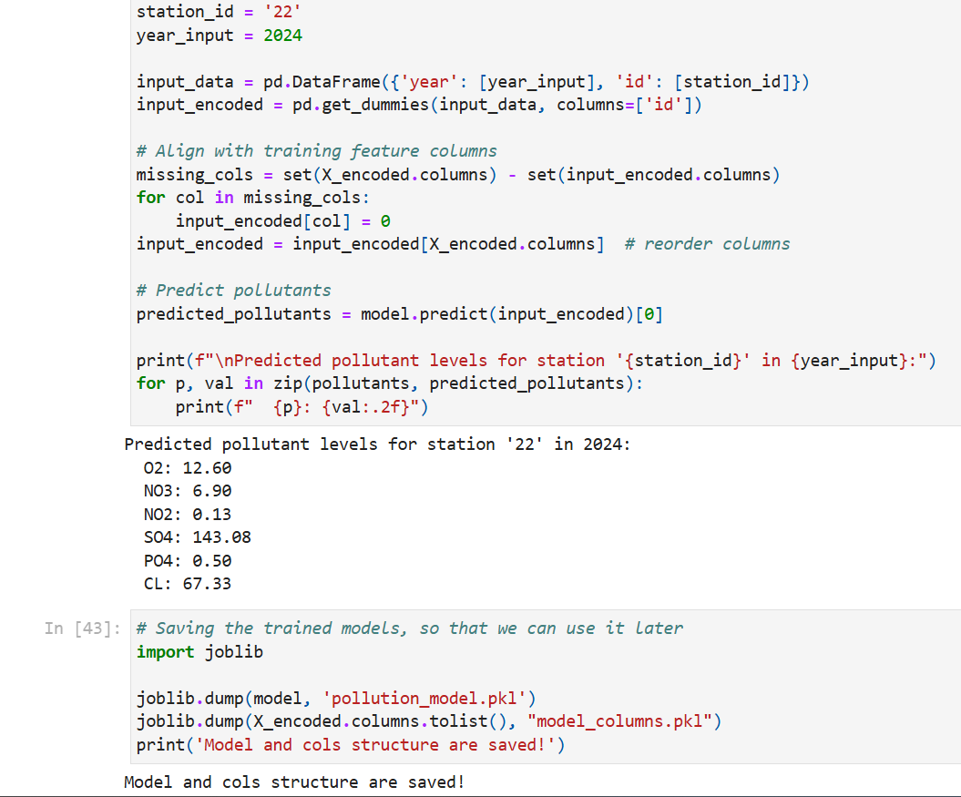
Screenshot of Output:

Slide 12
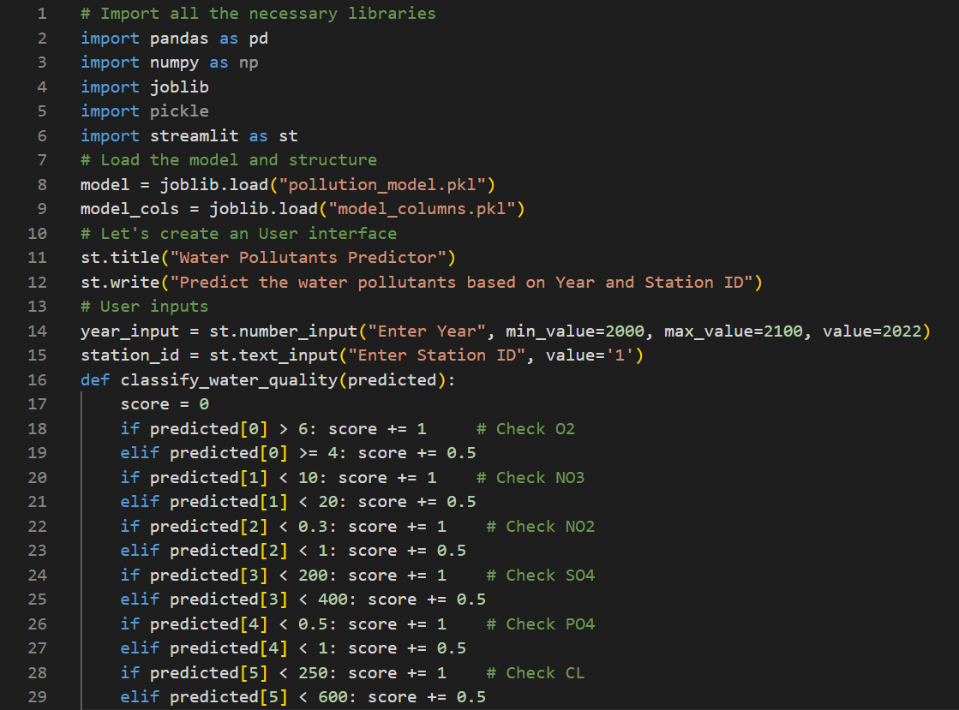
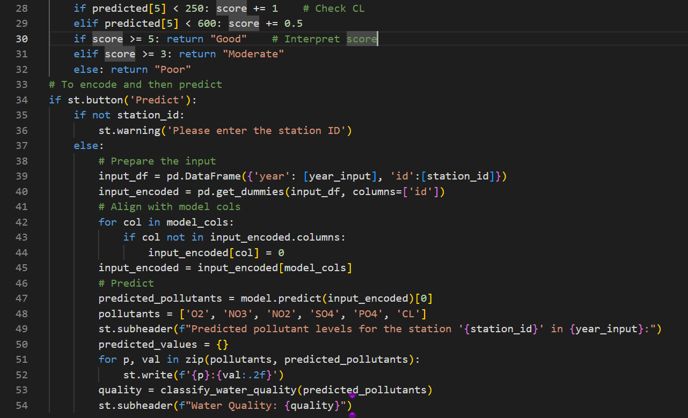
Screenshot of Code: (my_app.py)

Slide 13
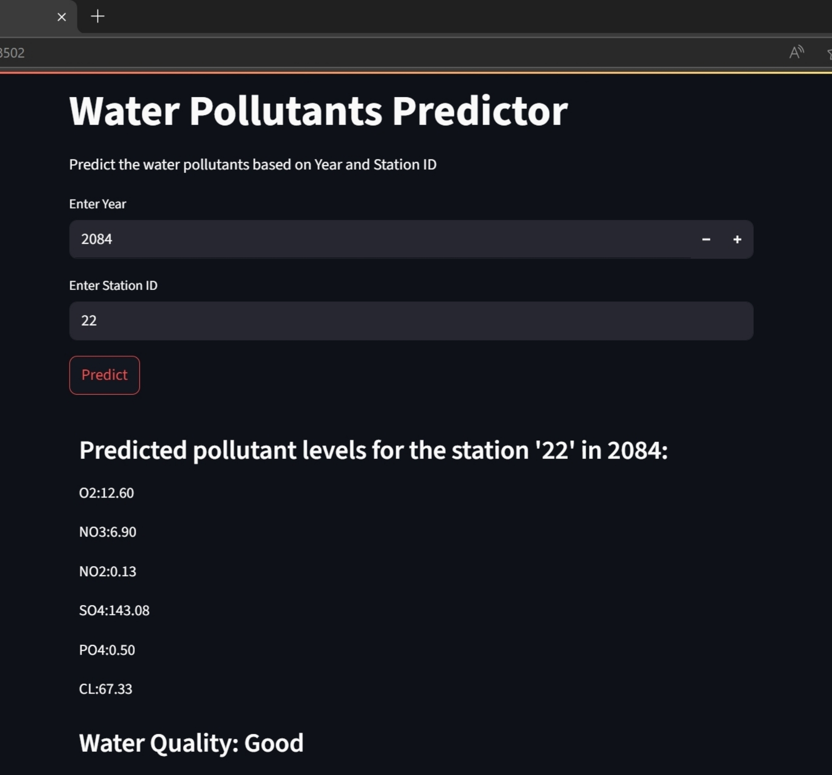
Screenshot of Output:

Slide 14
Conclusion:
A Significant Step Towards Predictive Water Quality Management:
The successful development and deployment of the Water Pollutants Predictor demonstrate the immense potential of machine learning in transforming environmental monitoring from a reactive to a proactive discipline. By accurately forecasting pollutant levels, this tool provides a crucial early warning system, enabling timely interventions and resource optimization. It validates the hypothesis that historical water quality data, combined with advanced analytical techniques, can yield valuable insights for environmental protection.
Key Achievements and Impact:
The system empowers stakeholders with predictive insights for timely interventions and optimized resource use. It enhances public health and environmental safety through data-driven water quality management.
Future Directions and Potential Enhancements:
Future improvements include integrating environmental factors, real-time data, and advanced time-series models to enhance prediction accuracy. Expanding pollutant scope and adding uncertainty quantification will enable deeper insights and more informed decisions.
GitHub Link:
https://github.com/Naveen-paidi/Water-Quality-Prediction

